Slide 1


Database
Isabel Doherty and Helen Youssef

Slide 2

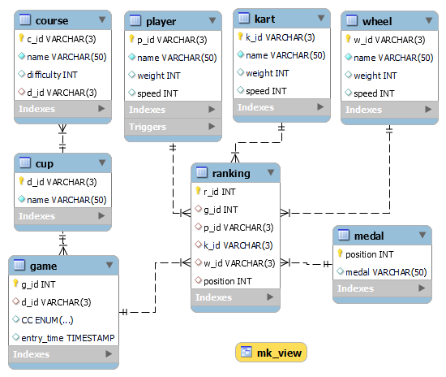
ER diagram
Our database via ER diagram
Relations between PKs and FKs shown by lines
This database obeys 3rd Normal Form as each non-key attribute depends only on the key

Slide 3
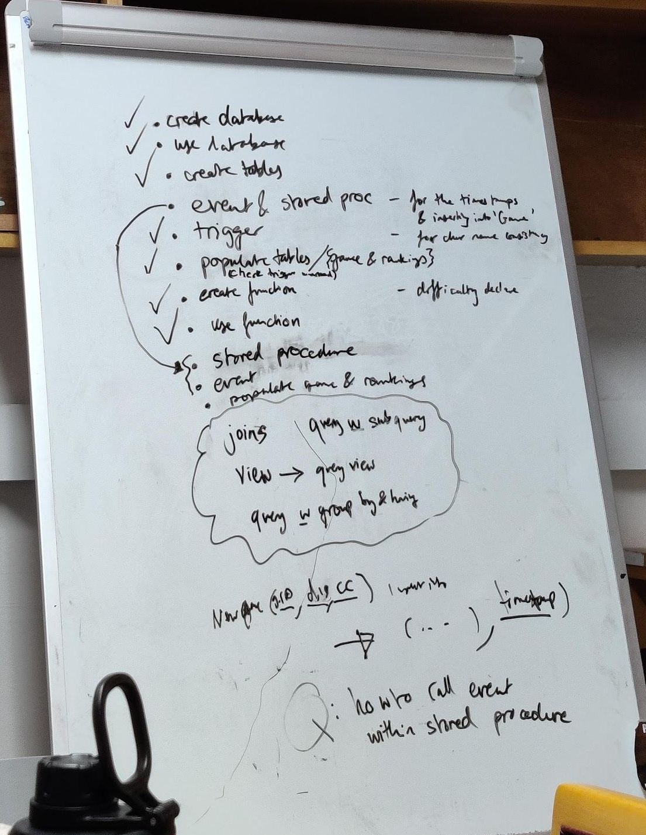
Contents
Create Tables
Create a Trigger
Populate Tables (w/o game & ranking)
Create a Function
Stored Procedure (used to populate game & ranking)
Event
Joins with ‘group by’ and ‘having’
Query with subquery
View and query

Slide 4
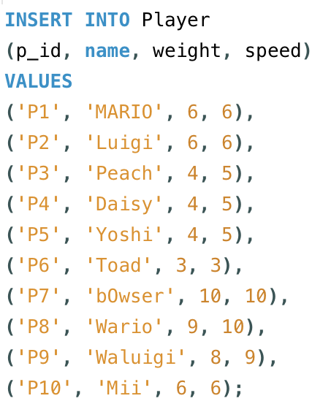
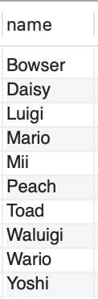
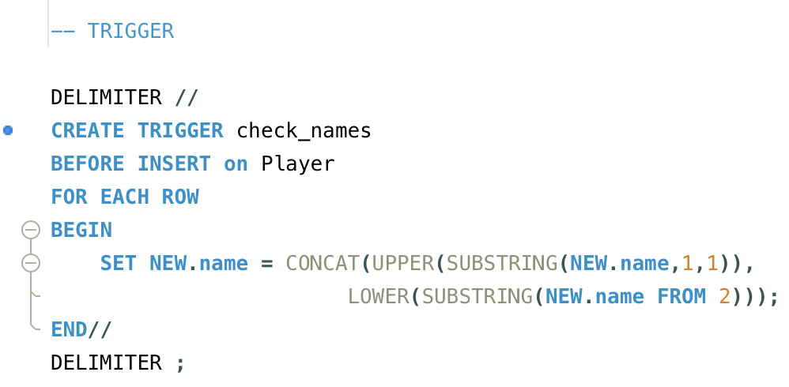
Trigger
How it displayed as results:
Our trigger was used to ensure the output of the character names would be consistent.
Code as entered:
Trigger Code:
Notes:
Isa

Slide 5
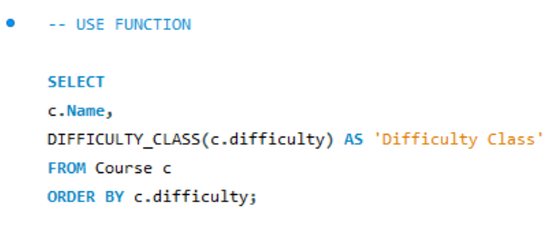
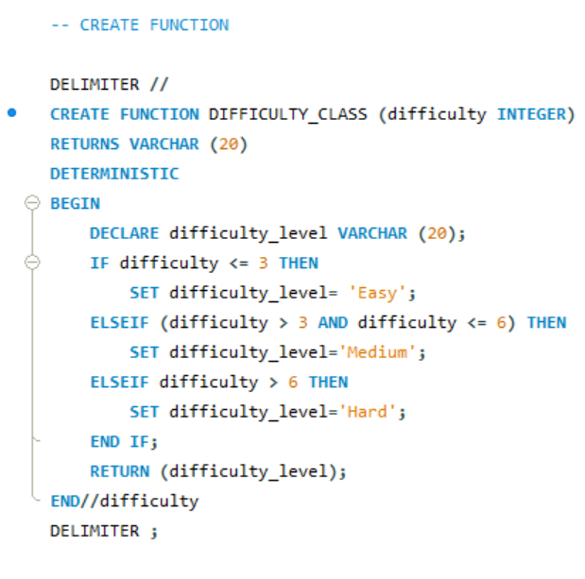
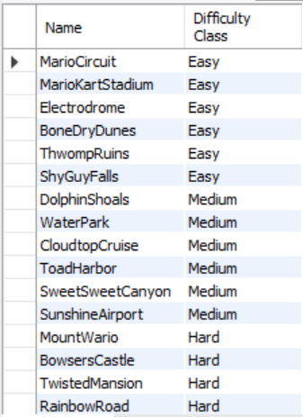
Function
We used a function to label courses as Easy, Medium, or Hard based on the difficulty scores we had assigned them.
Notes:
isa

Slide 6
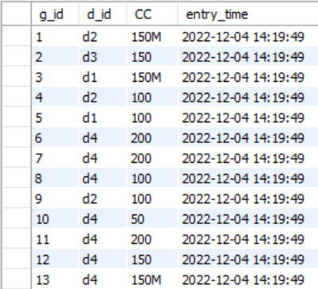
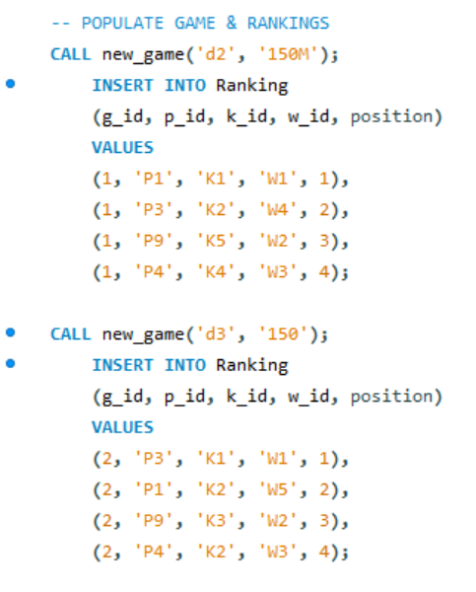
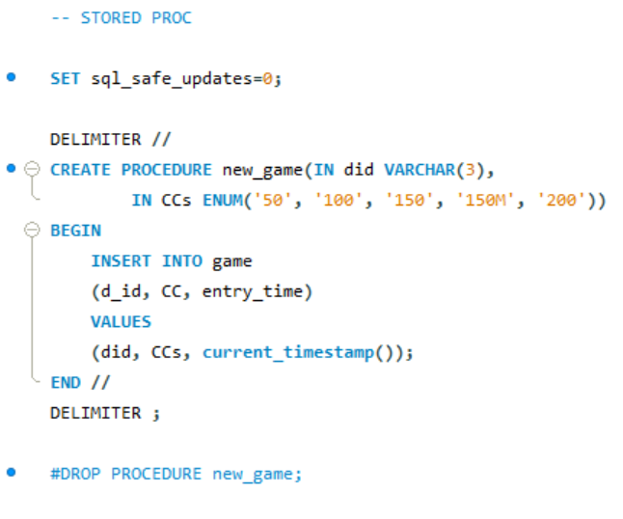
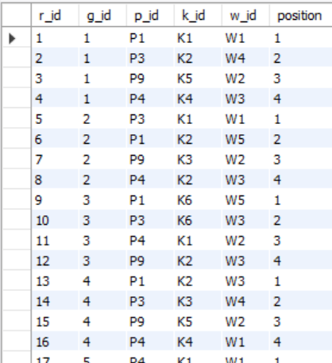
Stored Procedure
We created a stored procedure to insert new games into the games table with the timestamp of the current time
Notes:
me

Slide 7
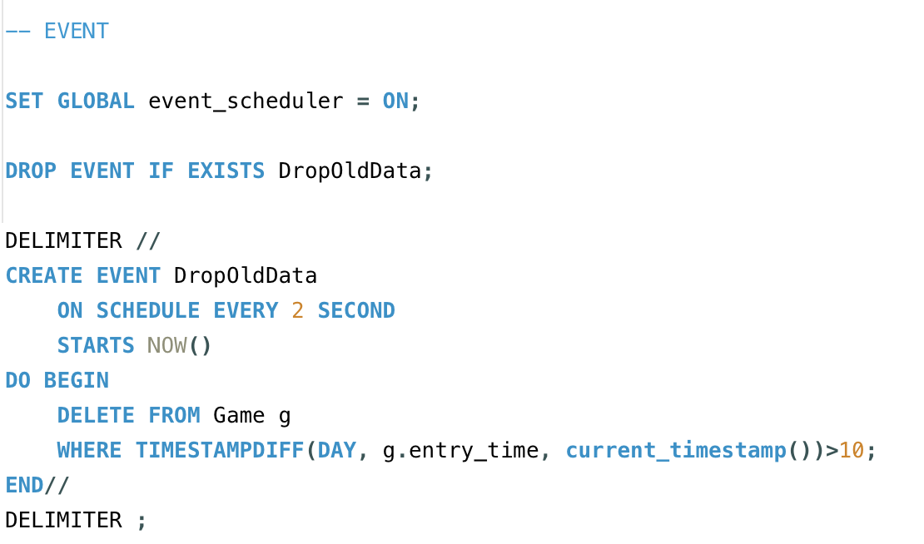
Event
We created an event to get rid of any data older than 10 days.
Notes:
isa

Slide 8
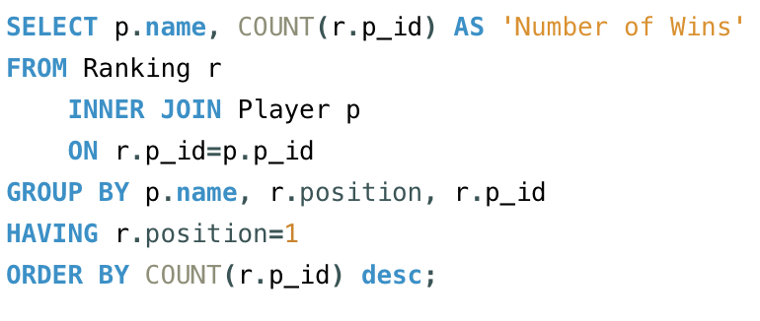
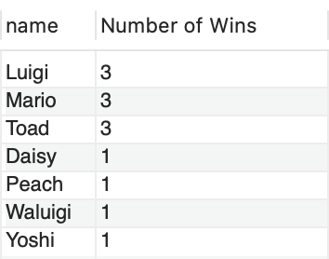
Joins and Group By and Having
We used an INNER JOIN and GROUP BY and HAVING statements to query the number of wins per winning player, ordered by most wins to least.
Notes:
isa

Slide 9
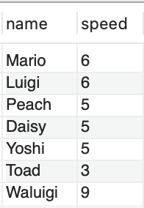
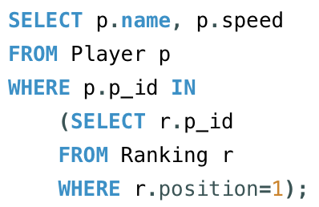
Subquery
We used a query with a subquery to show the player speeds of players who won at least one game.
Notes:
isa

Slide 10
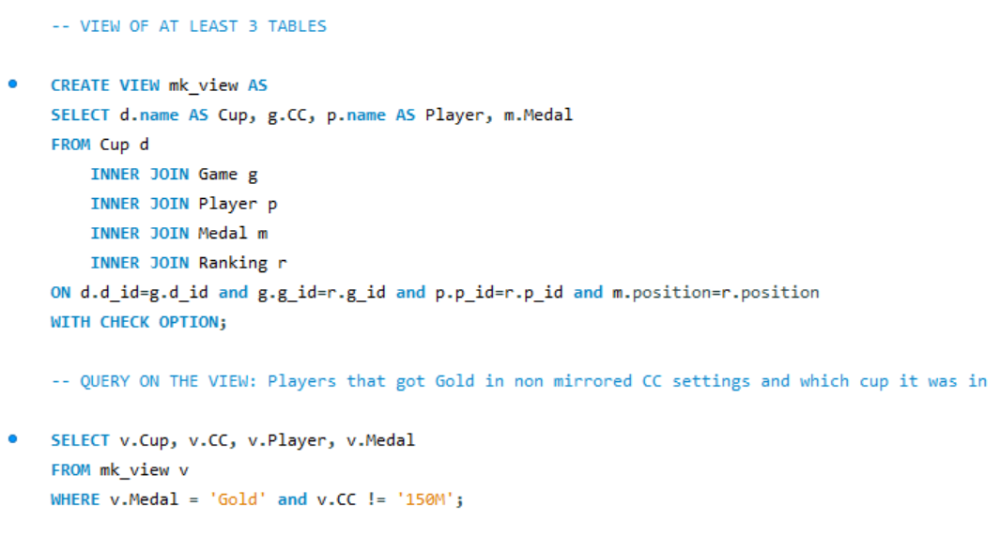
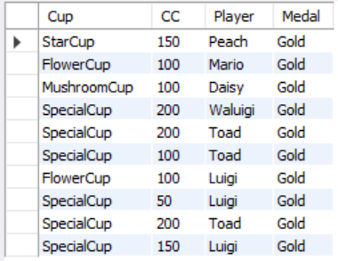
Views
We created a view that only included:
Cup, Player, Medal, CC
Everything else is confidential!
Notes:
me

Slide 11
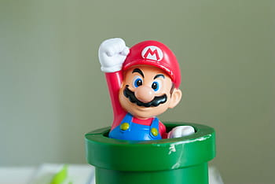
Thanks for listening!

